Slide 1
Data Visualization
Ying shen
Sse, tongji university
Jan. 2018

Slide 2
Outline
Introduction
Tasks in data visualization
Visualization by data type
Challenges for data visualization

Slide 3
Outline
Introduction
Tasks in data visualization
Visualization by data type
Challenges for data visualization

Slide 4
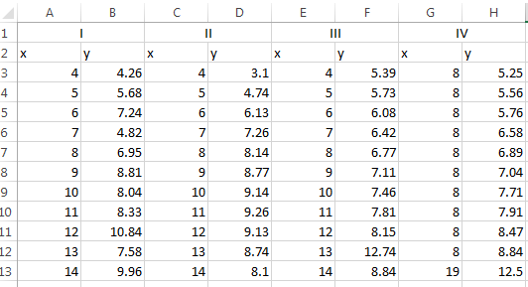
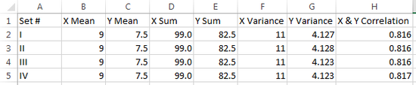
Introduction
The best medium for many tasks and types of data is a visual representation
  A picture is supposedly worth a thousand words!
Notes:
https://marketingland.com/brief-introduction-data-visualization-theory-marketers-184112?utm_source=tuicool&utm_medium=referral
Our brains are wired in such a way that we are more able to mentally process data and derive insights when it is graphed than when it is displayed in a tabular format such as in an Excel spreadsheet. To demonstrate this principle, let’s look at a tangible example: a famous dataset known as Anscombe’s quartet . The data consists of four sets, labeled in Roman numerals, which each contain an x and y coordinate. In Excel, the data are very difficult to digest and to derive insight from:
If we were to analyze these data with common summary statistics, we’d find that it looks very much the same:

Slide 5
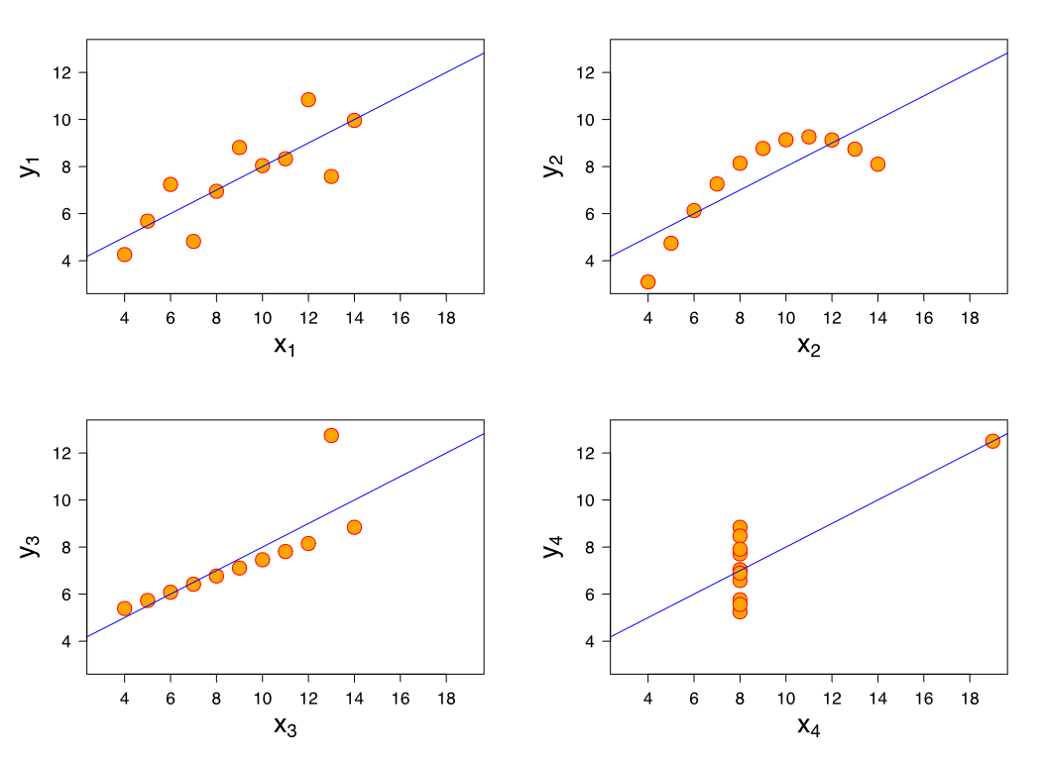
Introduction
The best medium for many tasks and types of data is a visual representation
  A picture is supposedly worth a thousand words!
Notes:
When graphed, we see some differences in the data:
Set I: Shows a simple, straight-lined linear regression.
Set II: Shows a non-linear relationship between X and Y in the form of an upside down parabola.
Set III: Shows another straight-lined regression, but with an obvious outlier.
Set IV: Doesn’t show a relationship between X and Y, and there is an even more obvious outlier than seen with Set III. All but one X value are equal to the same value, 8

Slide 6
Introduction
The best medium for many tasks and types of data is a visual representation
  Successful designers should adapt the data presentation based on what the user needs to do

Slide 7
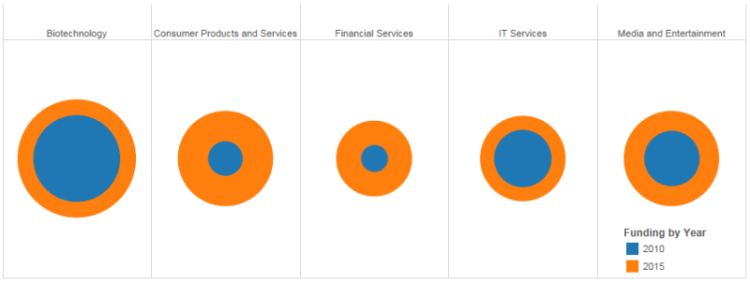
Introduction
The best medium for many tasks and types of data is a visual representation
  Successful designers should adapt the data presentation based on what the user needs to do
Notes:
The data used in the examples below compare how much venture capital funding was received by various industries in 2010 versus 2015.
Q:
Which industry received the greatest amount of venture capital funding in 2015?
Which industry received the second most amount of venture capital funding in 2015?
If you had to guess, what percent of funding did the Biotechnology industry receive in 2010 compared to 2015?
If you had to guess, what percent of funding did the Media and Entertainment industry receive in 2010 compared to 2015?

Slide 8

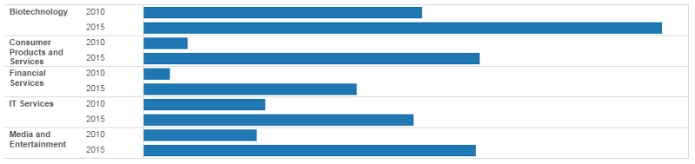
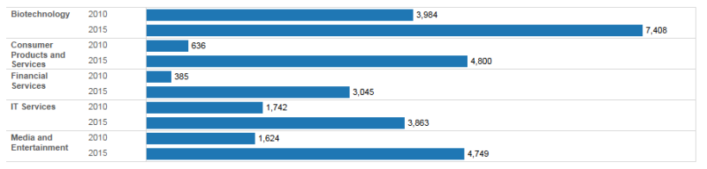
Introduction
The best medium for many tasks and types of data is a visual representation
  Successful designers should adapt the data presentation based on what the user needs to do
Notes:
The data used in the examples below compare how much venture capital funding was received by various industries in 2010 versus 2015.
Q:
Which industry received the greatest amount of venture capital funding in 2015?
Which industry received the second most amount of venture capital funding in 2015?
If you had to guess, what percent of funding did the Biotechnology industry receive in 2010 compared to 2015?
If you had to guess, what percent of funding did the Media and Entertainment industry receive in 2010 compared to 2015?

Slide 9
Introduction
This idea of data-driven pictures is called visualization
  Visualization provides compact graphical presentations and user interfaces for interactively manipulating large numbers of items, often extracted from large datasets
  Sometimes called visual data mining, it uses the enormous visual bandwidth and the remarkable human perceptual system to enable users to make discoveries, take decisions, or propose explanations about patterns, groups of items, or individual items.
Visual information seeking mantra:
  Overview first, zoom and filter, then details on demand

Slide 10
Outline
Introduction
Tasks in data visualization
Visualization by data type
Challenges for data visualization

Slide 11
Tasks in data visualization
Task Categories | Task Types
Data and view specification | Visualize data by choosing visual encodings Filter out data to focus on relevant items Sort items to expose patterns Derive values of models from source data
View manipulation | Select items to highlight, filter, or manipulate Navigate to examine high-level patterns and low level detail Coordinate views for linked exploration Organize multiple windows and workspaces
Process and provenance | Record analysis histories for revisitation, review, and sharing Annotate patterns to document findings Share views and annotations to enable collaboration Guide users through analysis tasks or stories

Slide 12
Data and view specification
Visualize data by choosing visual encodings
Filter out data to focus on relevant items
Sort items to expose patterns
Derive values of models from source data
Notes:
Be able to manipulate the view on the screen, including the ability to select items or regions, to navigate the viewport’s position on a large visualization, to coordinate multiple views so that data can be seen from multiple perspectives, and to organize the resulting dashboards and workspaces.

Slide 13
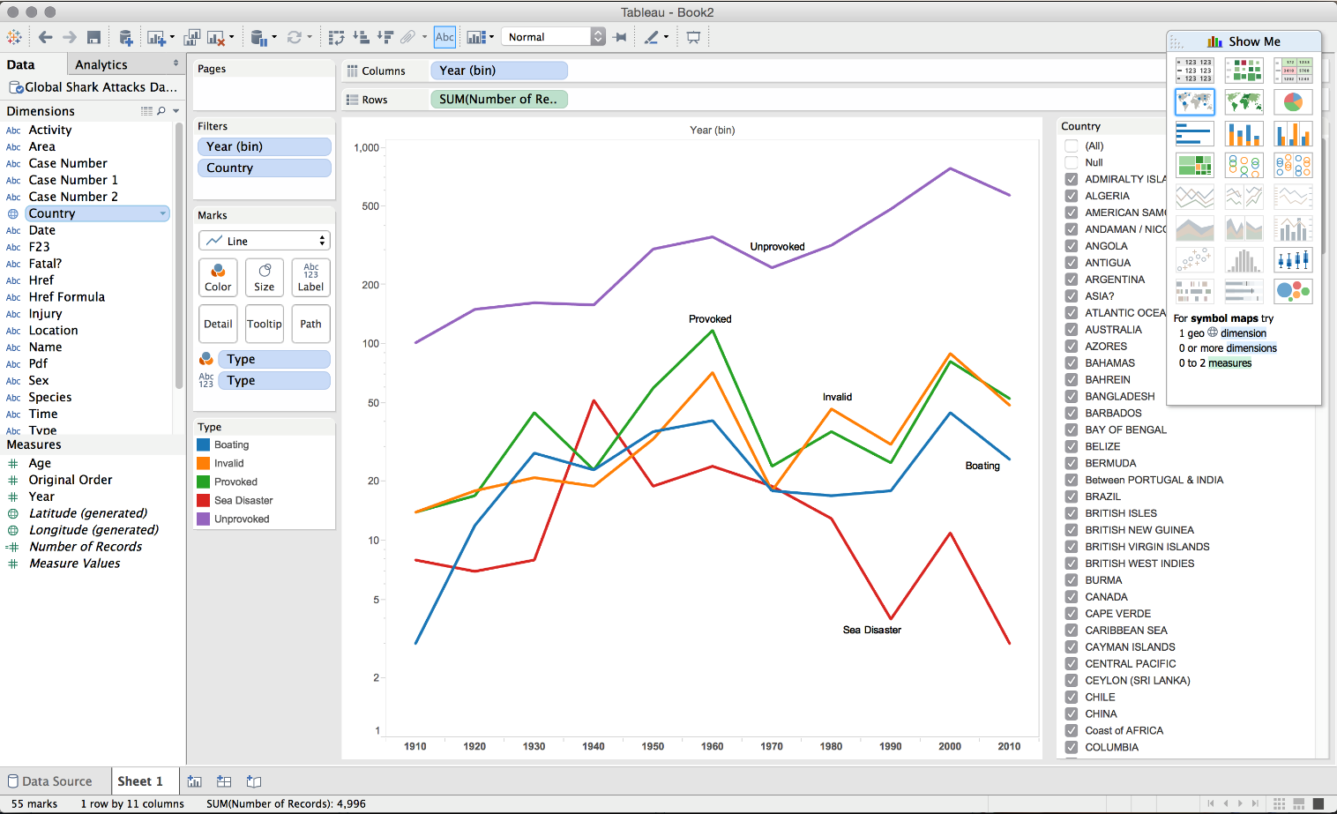
Visualize data by choosing visual encodings
Selecting a visual encoding for a particular dataset is the most fundamental operation
A common approach is providing a palette of available charts
Notes:
Visualization palette (upper right) in the Tableau Desktop application for a dataset of shark attacks
The “show me” feature in the tool (Mackinlay, 2007) will automatically highlight the suitable charts that can be used for the selected data

Slide 14
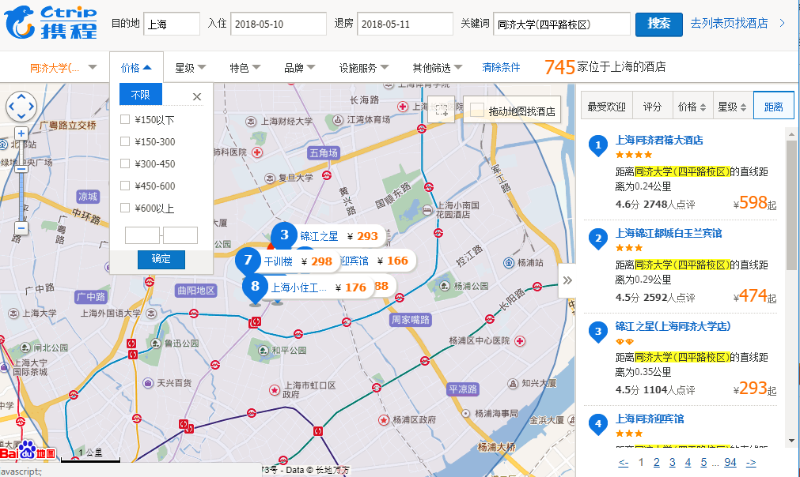
Filter out data to focus on relevant items
Eliminating unrelated information from the view is critical

Slide 15
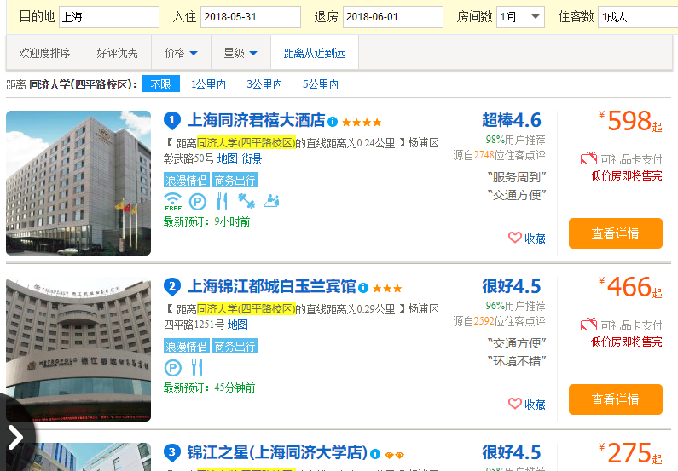
Sort items to expose patterns
Ordering data items according to some dimension
  Age, income, price...

Slide 16
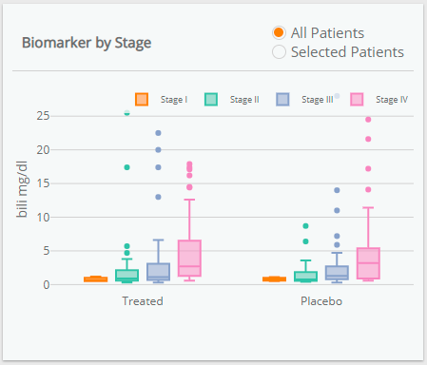
Derive values of models from source data
Calculate statistics (e.g., mean, median), transformations, etc.

Slide 17
View manipulation
Select items to highlight, filter, or manipulate
Navigate to examine high-level patterns and low-level detail
Coordinate views for linked exploration
Organize multiple windows and workspaces
Notes:
Be able to manipulate the view on the screen, including the ability to select items or regions, to navigate the viewport’s position on a large visualization, to coordinate multiple views so that data can be seen from multiple perspectives, and to organize the resulting dashboards and workspaces.

Slide 18
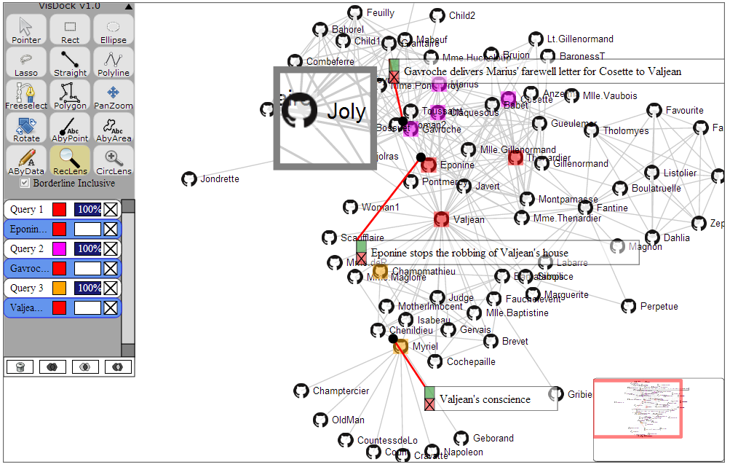
Select items to highlight, filter, or manipulate
Pointing to an item indicates the subject of action
Common forms of selection include clicks, mouse hover, and region selections
Notes:
Selection tools and data-aware annotations in an interactive node-link diagram representation of the social network for all of the characters in Victor Hugo’s Les Misérables
Characters are linked together if they appear in the same chapter in the book
The textual annotations are connected to nodes using red lines and stay connected as the graph layout changes
The toolbar on the upper left is part of the VisDock toolkit, and provides tools for annotation, navigation, and selection (Choi, 2015)

Slide 19
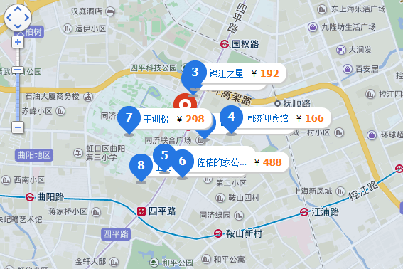
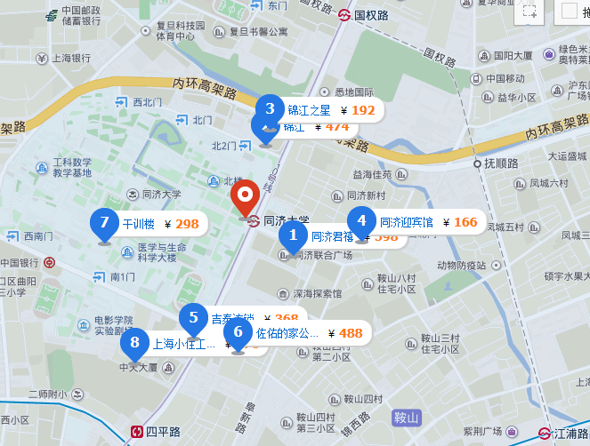
Navigate to examine high-level patterns and low-level detail
Navigation operations such as pan and zoom allow the user to control the size an position of viewport
  E.g., Google Maps, Adobe Photoshop, and Microsoft Word

Slide 20
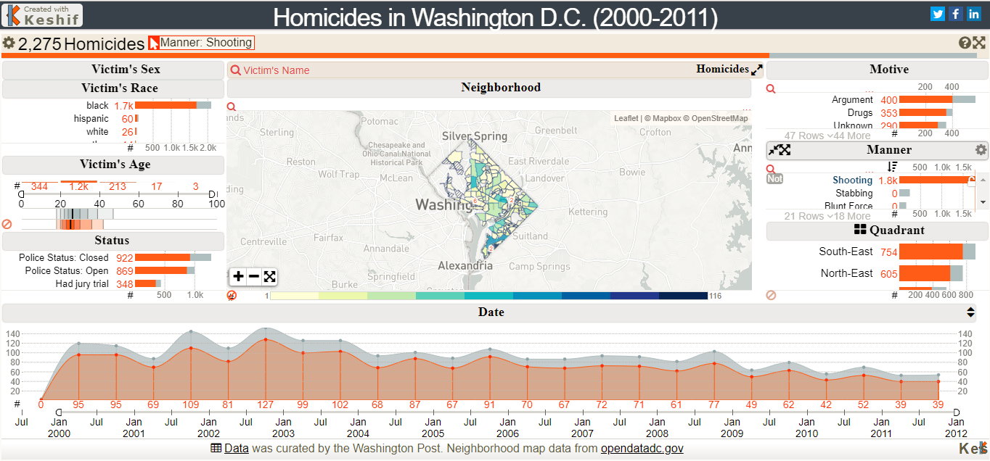
Coordinate views for linked exploration
Visualization tools often include multiple views of the same dataset
Selecting items in one view highlights them in others
Notes:
https://keshif.me/gallery/dc_homicides
Selecting items in one view highlights them in others; for example, the user is currently hovering over the bar for “70k-300k” in the view titled “# of Records”, which causes those breaches (i.e. 124 breaches that exposed in the range of 70,000 to 300,000 records) to also be highlighted in orange in other views, including in the timeline at the bottom

Slide 21
Organize multiple windows and workspaces
Many visualization tools allow for dragging and dropping views

Slide 22
Process and provenance
Record analysis histories for revisitation, review, and sharing
Annotate patterns to document findings
Share views and annotations to enable collaboration
Guide users through analysis tasks or stories
Notes:
If the previous two categories of tasks deal with the mechanics of creating, manipulating, and viewing visualizations, the third category encompasses higher-level tasks for scaffolding, interpreting, and documenting the exploration process. The tasks here involve the ability to record the analysis, to annotate regions of interest in a visualization, to share views with colleagues, and to guide others through presentations of analysis outcome

Slide 23
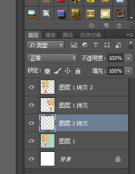
Record analysis histories for revisitation, review, and sharing
Graphical history interface using thumbnails of previous visualization states organized in a comic-strip layout (Heer, 2008)
  The labels describe the actions performed

Slide 24
Annotate patterns to document findings
Some tools allow for adding textual or graphical annotations
  Textual annotations constitute labels, captions, or comments
  Graphical annotations are sketches, highlights, or handwrite notes

Slide 25
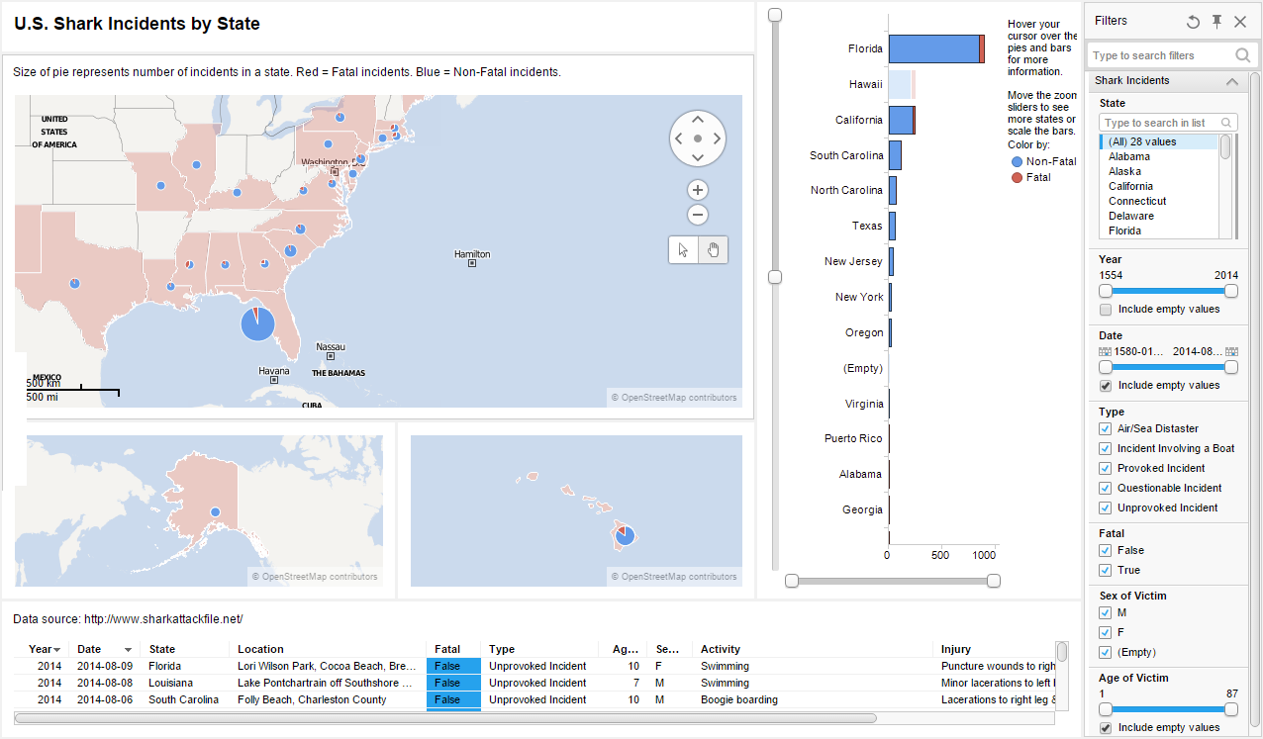
Share views and annotations to enable collaboration
Analyzing data is often a social activity involving multiple users
Visual analytics tools should support social interaction
Notes:
Spotfire visualization dashboard of shark attacks published on the web
The dashboard can be interacted, causing views to update dynamically
The tool also allows for application bookmarking (storing the state for specific insights) as well as sharing the analysis on social media platforms such as Facebook, Twitter, and LinkedIn

Slide 26
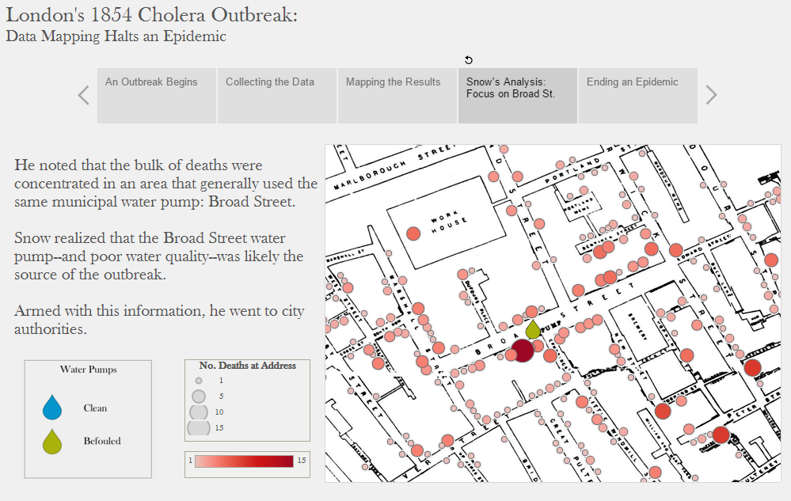
Guide users through analysis tasks or stories
Web-based visualization of London’s 1854 cholera outbreak showing physician Jon Snow’s use of visualization to find its source
Notes:
This visualization was created in Tableau using its Story Points feature that allows users to build a narrative from data
The horizontal list of five boxes at the top of the display are the main points in the story, and viewers can be automatically guided through the story by moving to each point from left to right

Slide 27
Outline
Introduction
Tasks in data visualization
Visualization by data type
Challenges for data visualization

Slide 28
Visualization by data types
There are no unified theory which recommend the optimal visualization technique given the data type
Most datatypes don’t have a straightforward mapping from symbolic to visual form
All visualization techniques have their strengths and weaknesses
Data Types | Task Types
1-D linear | Tag clouds, Wordle, PhraseNets, parallel tag clouds
2-D space | Geographic information systems (GIS), self-organizing maps
3-D volume | Volume rendering, medical visualization, molecule visualization
Multi-dimensional | Tableau, parallel coordinates, scatterplot matrices
Temporal | Google Finance, EventFlow, LifeLines, TimeSearcher
Tree | Treemaps, degree of interest trees, space trees
Network | Node-link diagrams, adjacency matrices, NodeXL, Cytoscape
Notes:
This section gives an overview of seven common data types and some representative visualization techniques for each type

Slide 29

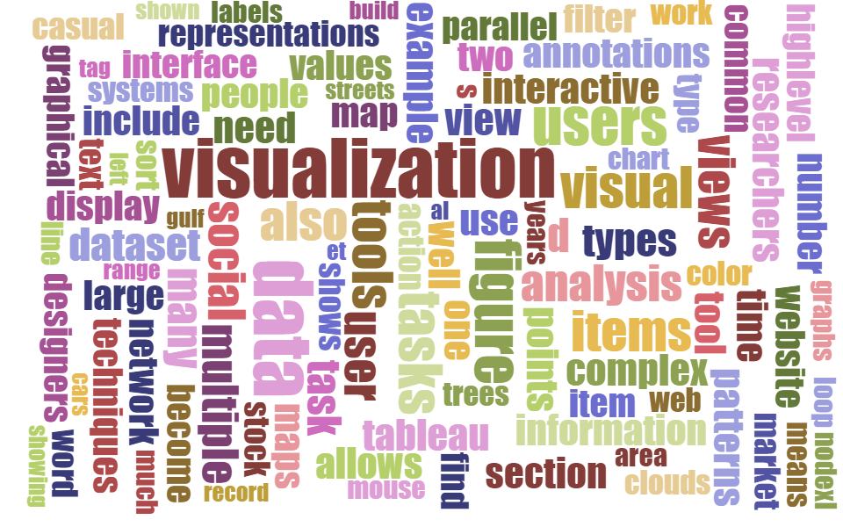
1D linear data
Linear data types are one dimensional
  E.g., source code, textual documents, dictionaries, and alphabetical lists of names
  Can be organized in a sequential manner
Notes:
While tag clouds summarize popular tags used in collaborative tagging applications, word clouds display statistics about word usage in a text collection
Here, a word cloud generated by the online generator at https://www.jasondavies.com/wordcloud/ shows the most frequent words in Chapter 16 of this book

Slide 30
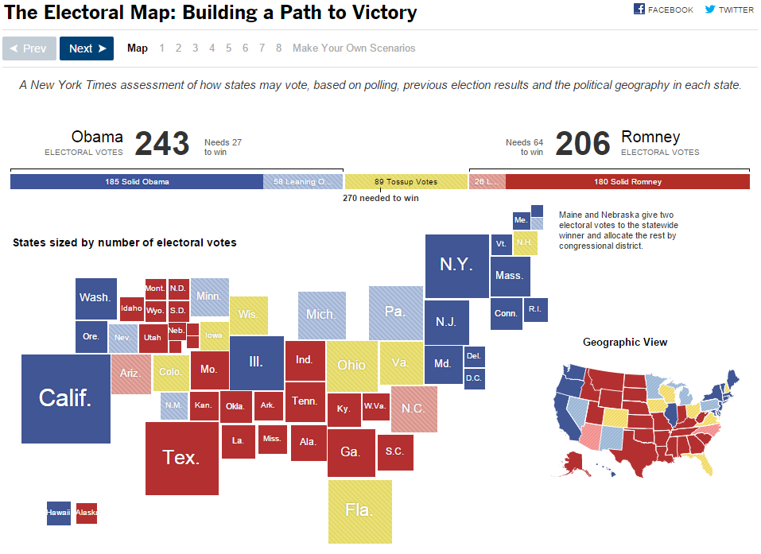
2D space data
Planar data include geographic maps, floor plans, and newspaper layouts
Each item in the collection has task-domain attributes (name, owner, and value) and interface-domain features (shape, size, color, and opacity)
Notes:
New York Times Electoral Map for the 2012 U.S. presidential election showing the final results for each of the states (http://elections.nytimes.com/2012/electoral-map)
The main map uses square shapes for each state, sized according to the number of electoral votes
This gives a quick indication of the importance of each state on the overall race
The smaller map on the right shows the actual geographic view

Slide 31
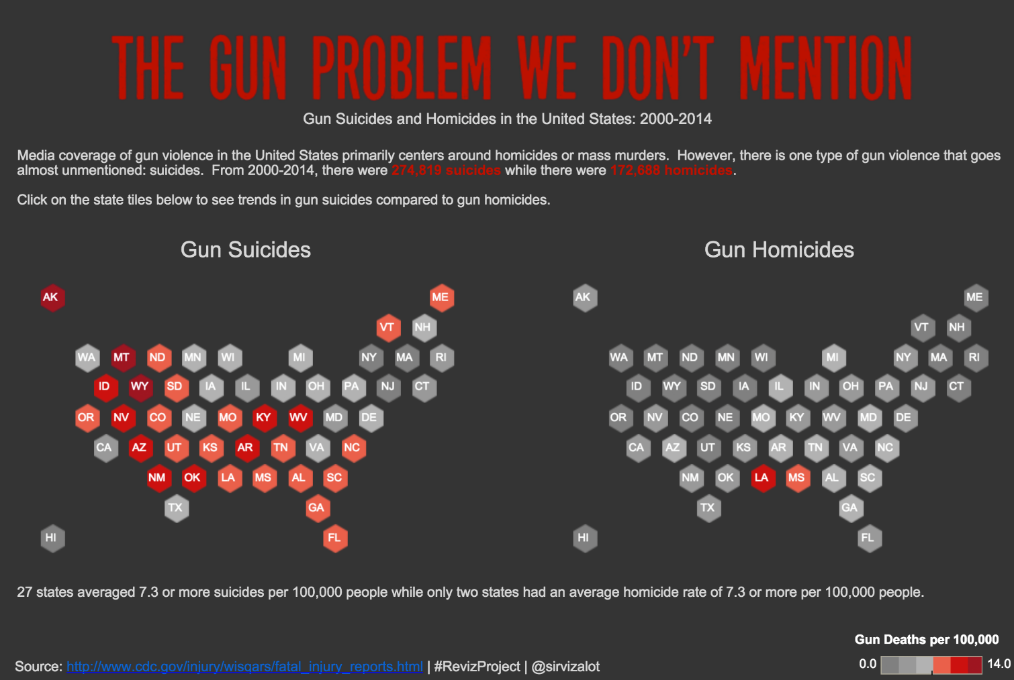
Another 2D space data example
Geographic visualization of gun deaths (suicides versus homicides) in the United States from 2000 to 2014 using data from the Center for Disease Control and Prevention (CDC).
Notes:
Instead of using the actual geographic boundaries of the individual states, this map replaces states with uniform hexagons that have been color-coded using the color scale on the bottom right. The benefit of this representation is to prevent large states from dominating the visual appearance of the overall map. The hexagons have been placed so that they largely preserve the topology of the original map.

Slide 32
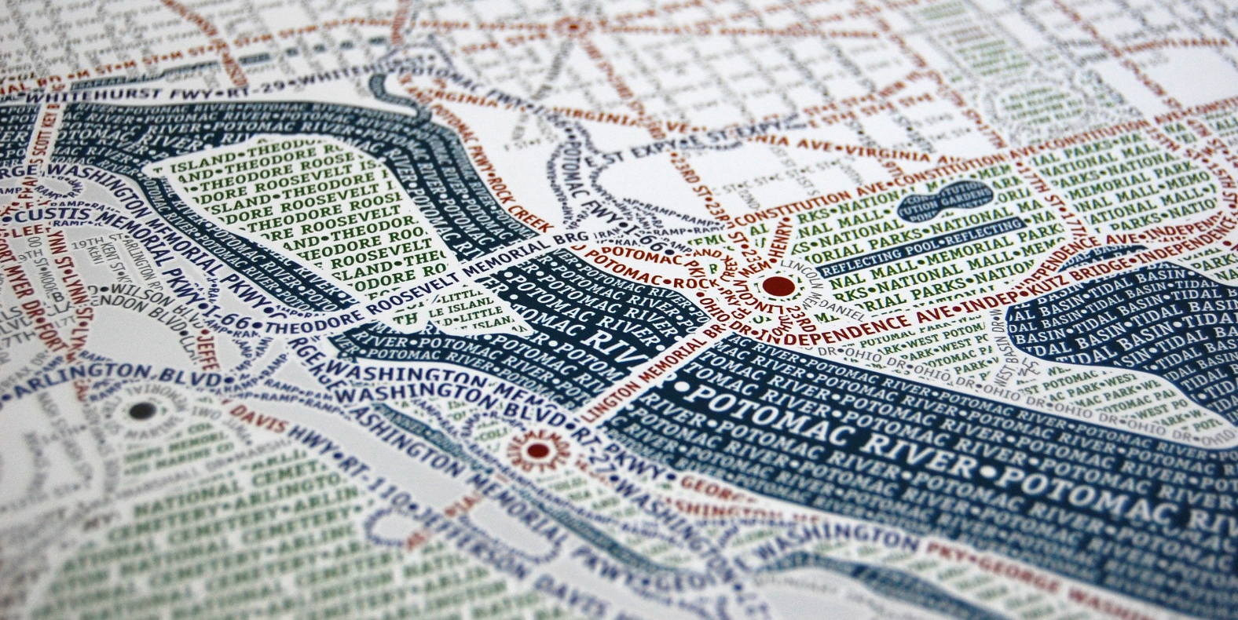
Another 2D space data example
Typographic map of Washington D.C. created by Axis Maps
Notes:
A typographic map consists entirely of text organized into shapes using colored labels of streets, parks, highways, shorelines, and neighborhoods
While this map took a skilled cartographer hundreds of painstaking hours to create, Afzal et al. (2012) later proposed an automatic approach taking mere minutes

Slide 33
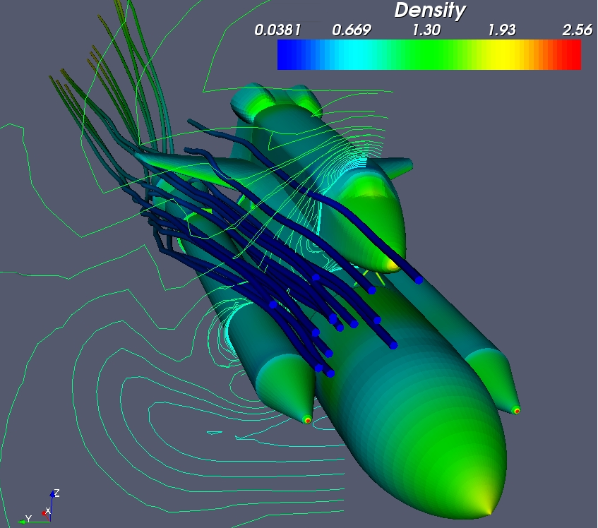
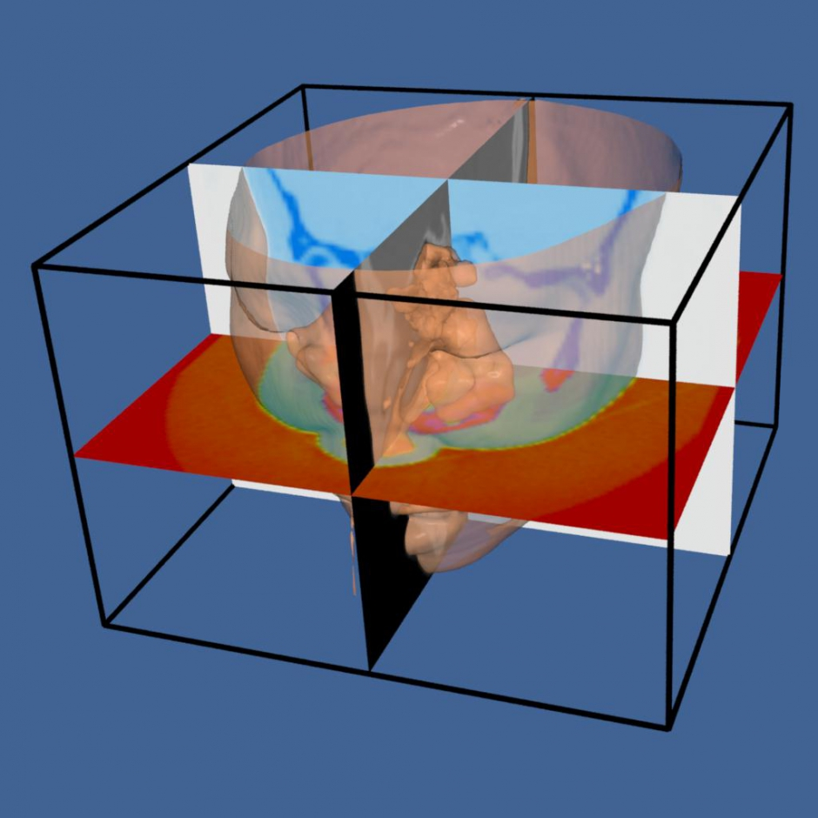
3D volume data
Real world objects have volume and complex relationships with other items
Notes:
Two 3D visualizations created using the Visualization Toolkit (VTK), a commercial software development library by Kitware, Inc (http://www.kitware.com/)
The left image shows flow density around the space shuttle using a rainbow color scale
The right image shows a CT scan of a human head with cross-sectional planes through the data

Slide 34
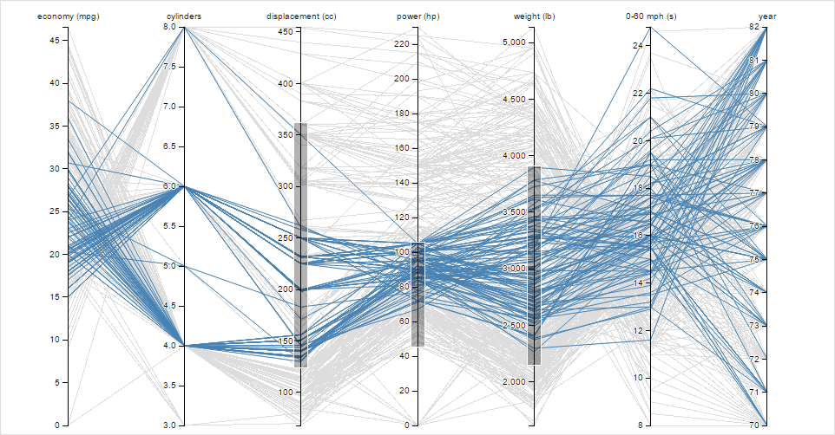
Multi-dimensional data
When the number of data dimensions exceeds three, the dataset is said to be multidimensional
Such data are commonly found in relational databases as well as speadsheets
Notes:
Parallel coordinate visualization of cars from the 1970s and 1980s created using the D3 library
This visualization supports axis filtering where selecting data ranges on the dimension axes filters out the cars that do not meet all of the criteria (gray lines)

Slide 35
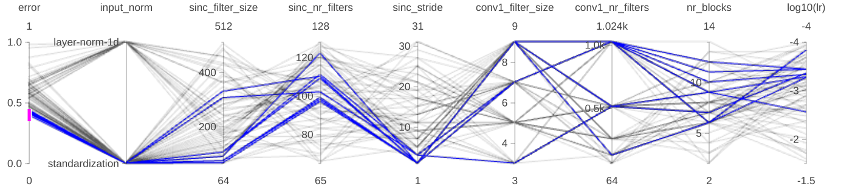
Multi-dimensional data
When the number of data dimensions exceeds three, the dataset is said to be multidimensional
Such data are commonly found in relational databases as well as speadsheets
Frame
Error
Rate
≤45%

Slide 36
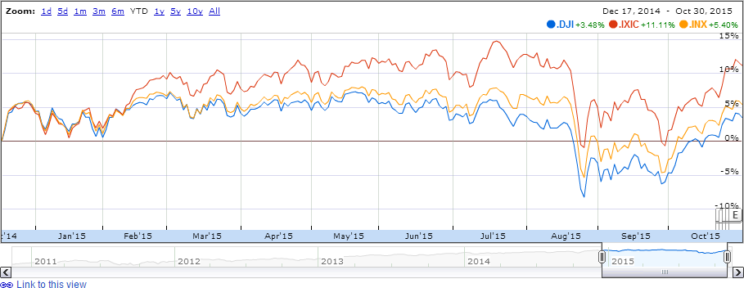
Temporal data
Virtually all datasets can have a temporal component by collecting data points over time
  E.g. electrocardiograms, stock market prices, or weather data
Notes:
Google Finance line graph showing the year-to-date performance of three stock market indices: the Dow Jones Industrial Average (.DJI, blue), the NASDAQ Composite (.IXIC, red), and the S&P 500 (.INX, yellow)
The overview window at the bottom shows several years of data from 2011 to present day; grabbing the window allows for panning and resizing the detail view (top)

Slide 37
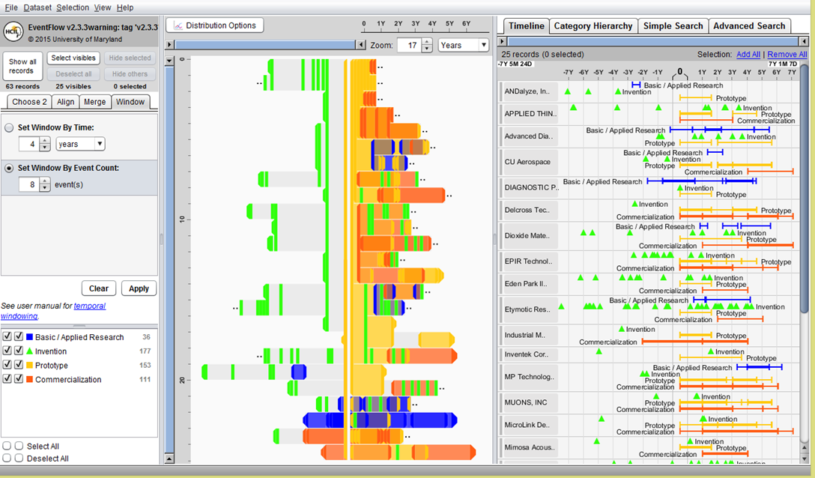
Another temporal data example
Notes:
The EventFlow (http://www.cs.umd.edu/hcil/eventflow) temporal event visualization system used to visualize sequences of innovation activities by Illinois companies
Activity types include research, invention, prototyping and commercialization
The timeline (right panel) shows the sequence of activities for each company
The overview panel (center) summarizes all the records aligned by the first prototyping activity of the company
In most of the sequences shown here the company’s first prototype is preceded by two or more patents with a lag of about one year between the last patent application and the first prototype

Slide 38
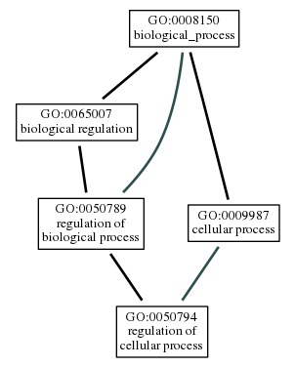
Tree data
Hierarchies or trees are collections of items where each item has a link to one parent item
  Items and the links between parents and children can have multiple attributes
  Interactions can be applied to items, links, and structural properties
Notes:
http://amigo.geneontology.org/amigo/dd_browse

Slide 39
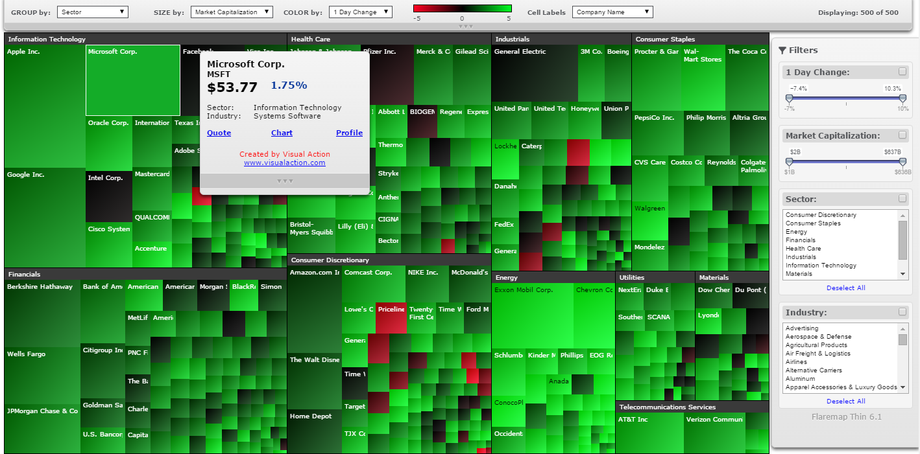
Tree data – treemaps
Treemaps are a space-filling approach that shows arbitrary-sized trees in a fixed rectangular space
Notes:
https://en.wikipedia.org/wiki/Treemapping
The S&P 500 Market Monitor by Visual Action (http://www.visualaction.com/), a web-based treemap visualization showing stock performance of the 500 large companies making up the S&P 500 index on the NYSE and NASDAQ stock markets
Each rectangle represents a company, sized according to its market capitalization, colored based on its 1-day change, and organized into their sectors

Slide 40
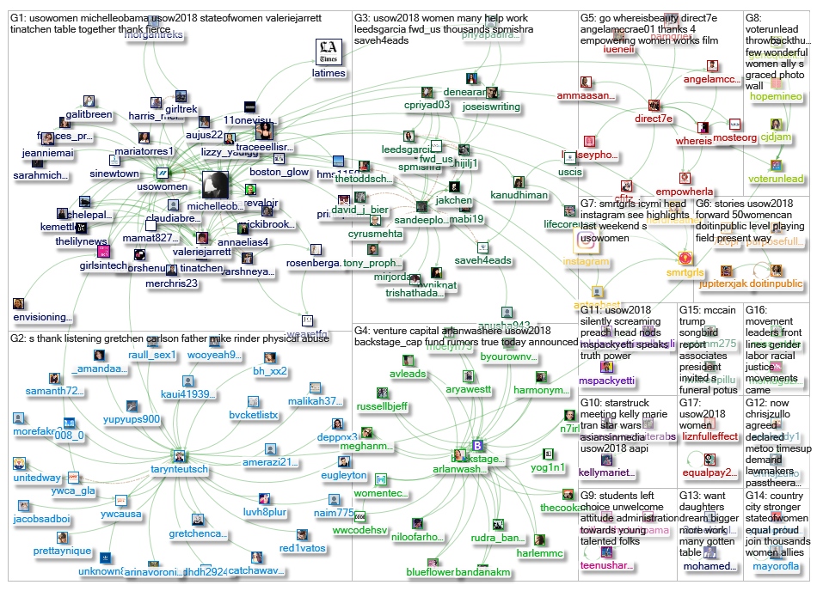
Network data
Networks represent arbitrary relationship between items
  Users want to find the shortest paths connecting two items or traversing the entire network
Node-link diagrams are one type of interface representation
Notes:
The graph represents a network of 149 Twitter users whose recent tweets contained "#USOW2018", or who were replied to or mentioned in those tweets, taken from a data set limited to a maximum of 18,000 tweets. The network was obtained from Twitter on Friday, 11 May 2018 at 03:10 UTC.
The graph's vertices were grouped by cluster using the Clauset-Newman-Moore cluster algorithm.
The graph was laid out using the Harel-Koren Fast Multiscale layout algorithm.
NodeXL (https://nodexl.codeplex.com/) allows social scientists to collect, analyze, and visualize network graphs using a familiar interface by plugging into Microsoft Excel

Slide 41
Outline
Introduction
Tasks in data visualization
Visualization by data type
Challenges for data visualization

Slide 42
Challenges for data visualization
Importing and cleaning data
Integrating data mining
Viewing big data
Achieving universal usability
Supporting casual users
Dissemination and storytelling
Adapting to any device
Evaluation

